Slide 1
Psemi Mirafra Sync
Mirafra Software Technology Pvt Ltd.

Slide 2
Agenda
1) PE24103 PMbus : Registers ( Existing 8 bit standard PMBus Commands to I2C 16 bit registers subset)
2) Device Identification based on register response : PE24103 & MYT0424
3) New device creation : PE24104
Mirafra Software Technology Pvt Ltd.

Slide 3
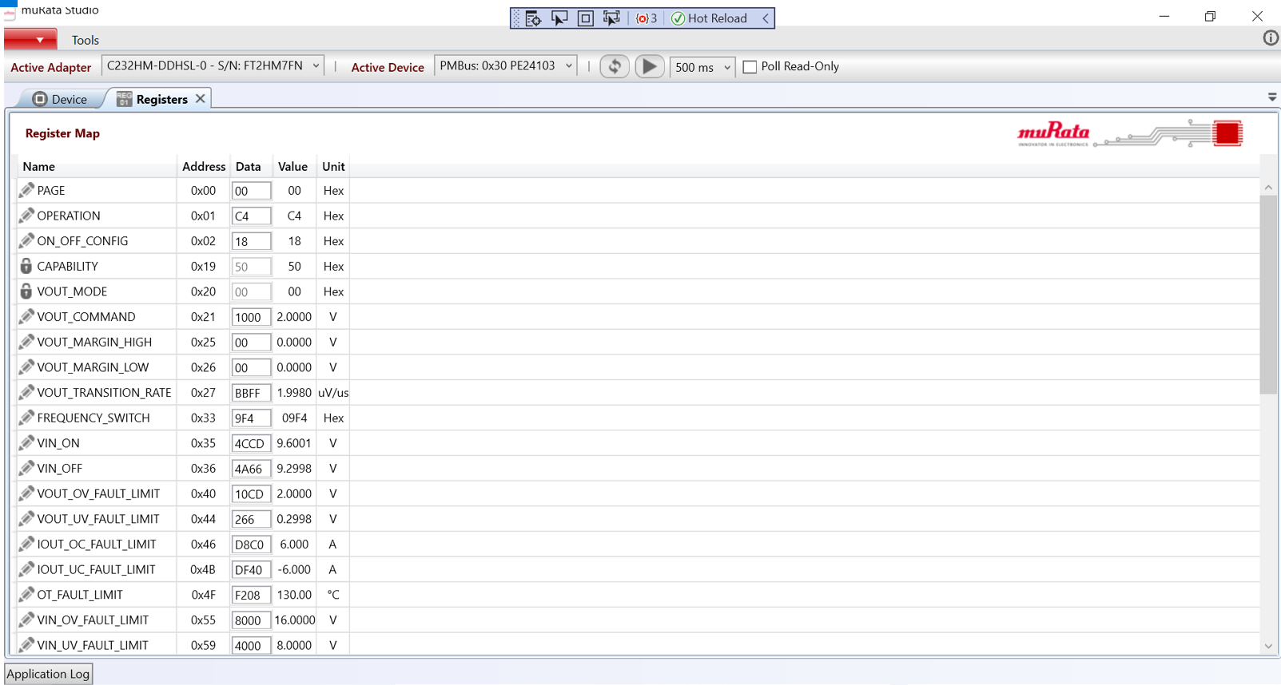
Device Identification – PMBus Registers
PE24103 PMbus – Contain standard PMBus commands
Mirafra Software Technology Pvt Ltd.

Slide 4
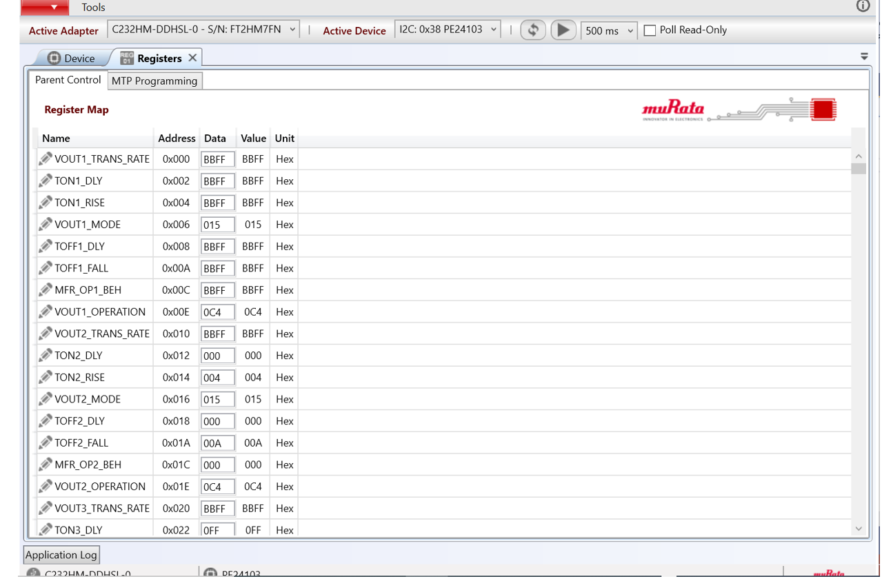
PE24103 I2C - Registers
Mirafra Software Technology Pvt Ltd.

Slide 5
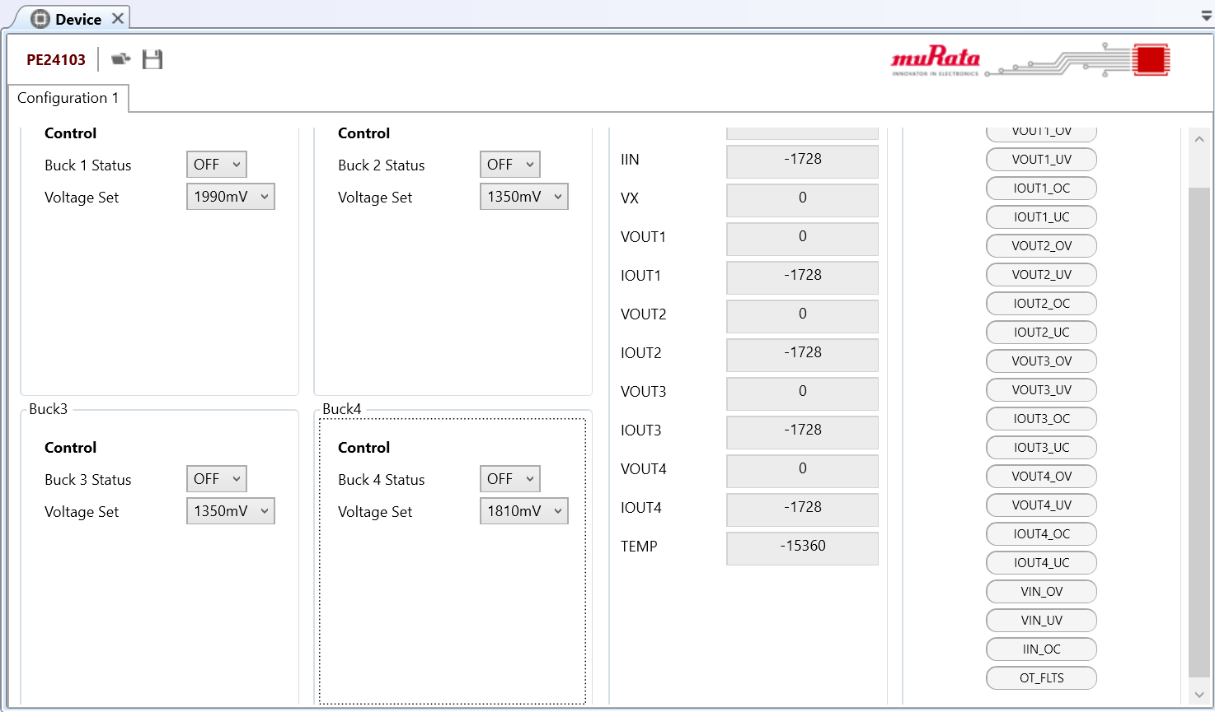
New device - PE24104
Based on PMBus protocol – Doesn’t support 16 bit registers.
Device Tab GUI Control ?
Mirafra Software Technology Pvt Ltd.

Slide 6
Thank you !
Mirafra Software Technology Pvt Ltd.

